Slide 1

FREELANCE TECHNICIAN
Final Major Project
Heather Fishwick

Slide 2


CONTEXT
PROJECT AIMS
32% of the creative industry is self-employed
Put myself out as a freelance live technician, specialising in lighting.
Aim to get both internal and external placements covering live music and theatre.
Notes:
List off some placements
Different venues = diff tech spec, diff light rig, diff software
Multiple shows, varied portfolio
Ultimate goal – push into freelancing career

Slide 3
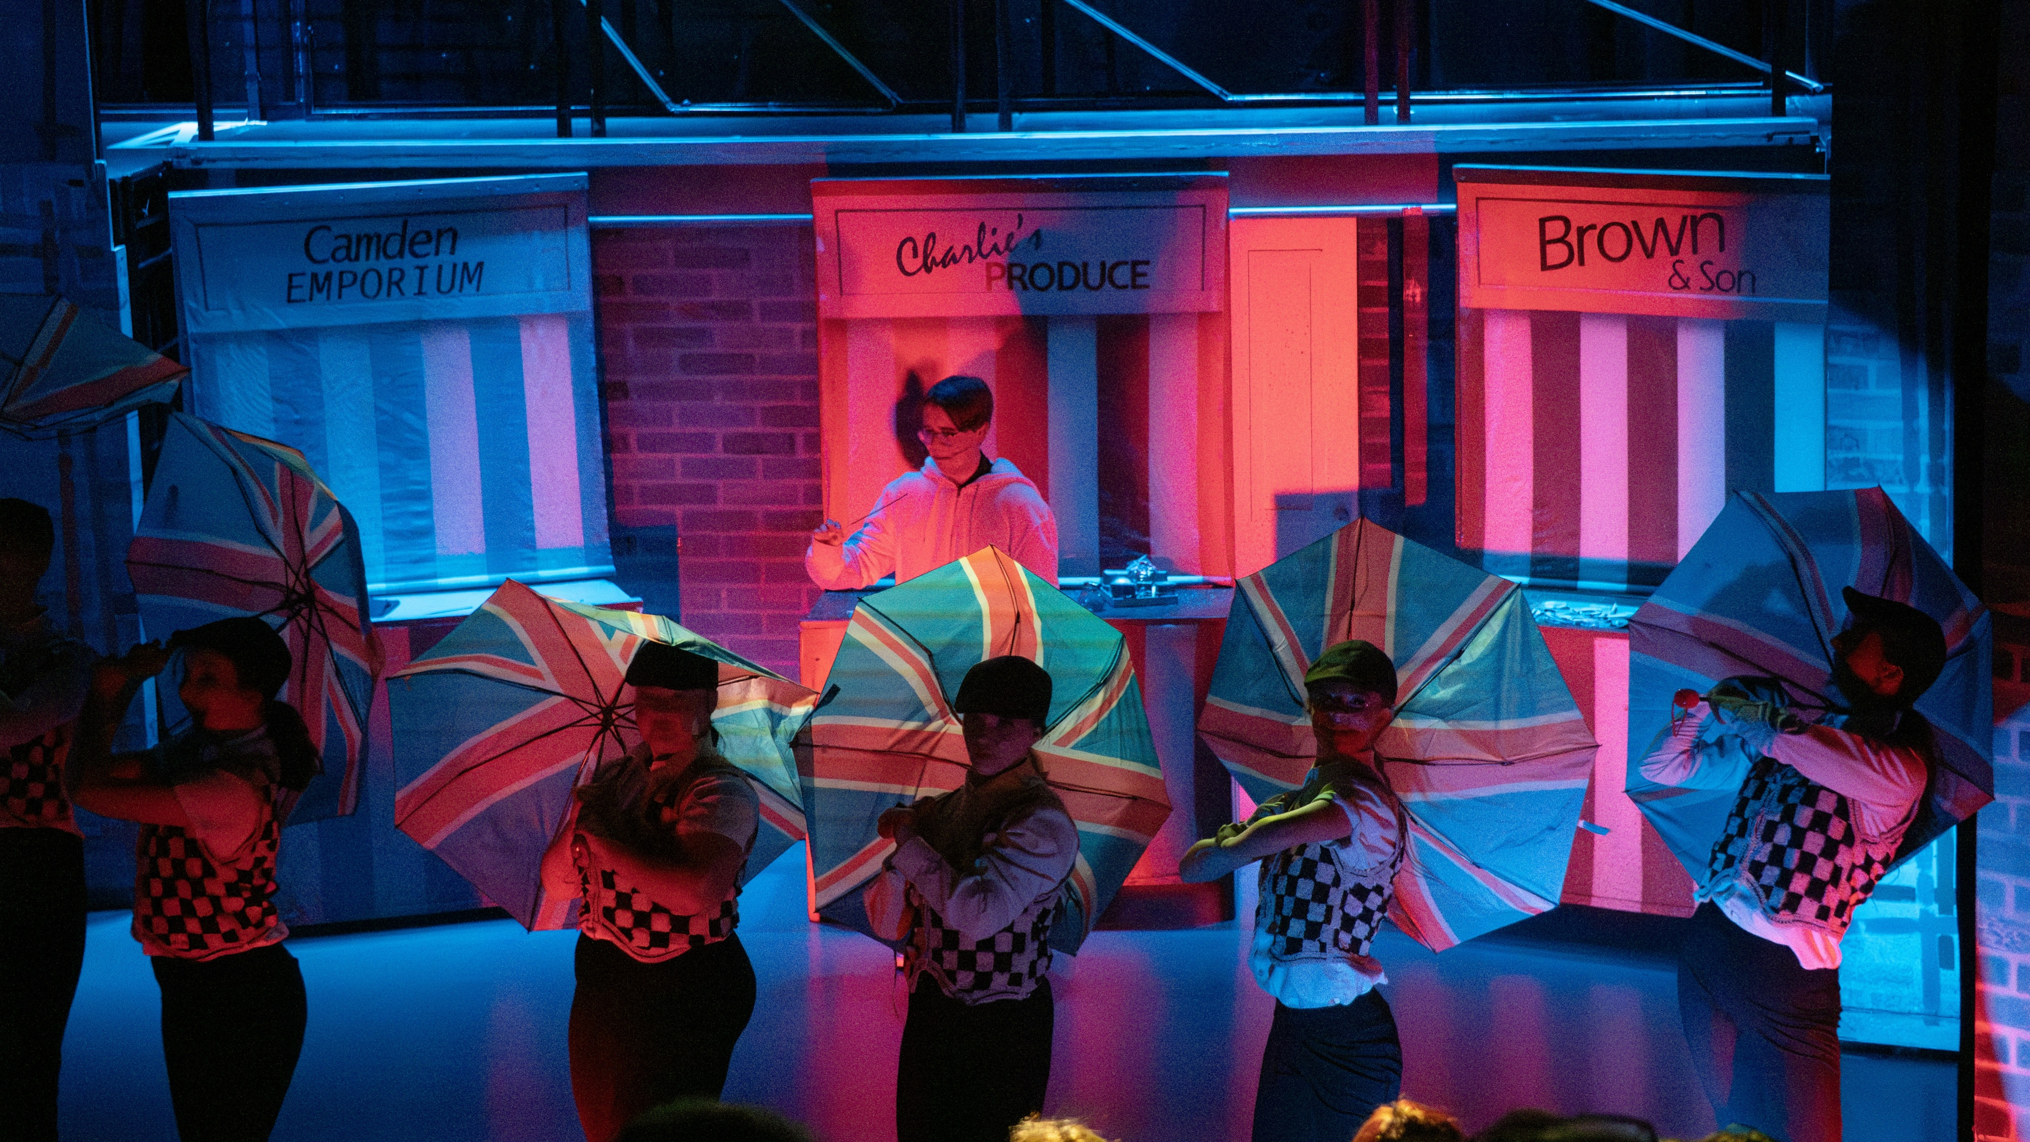
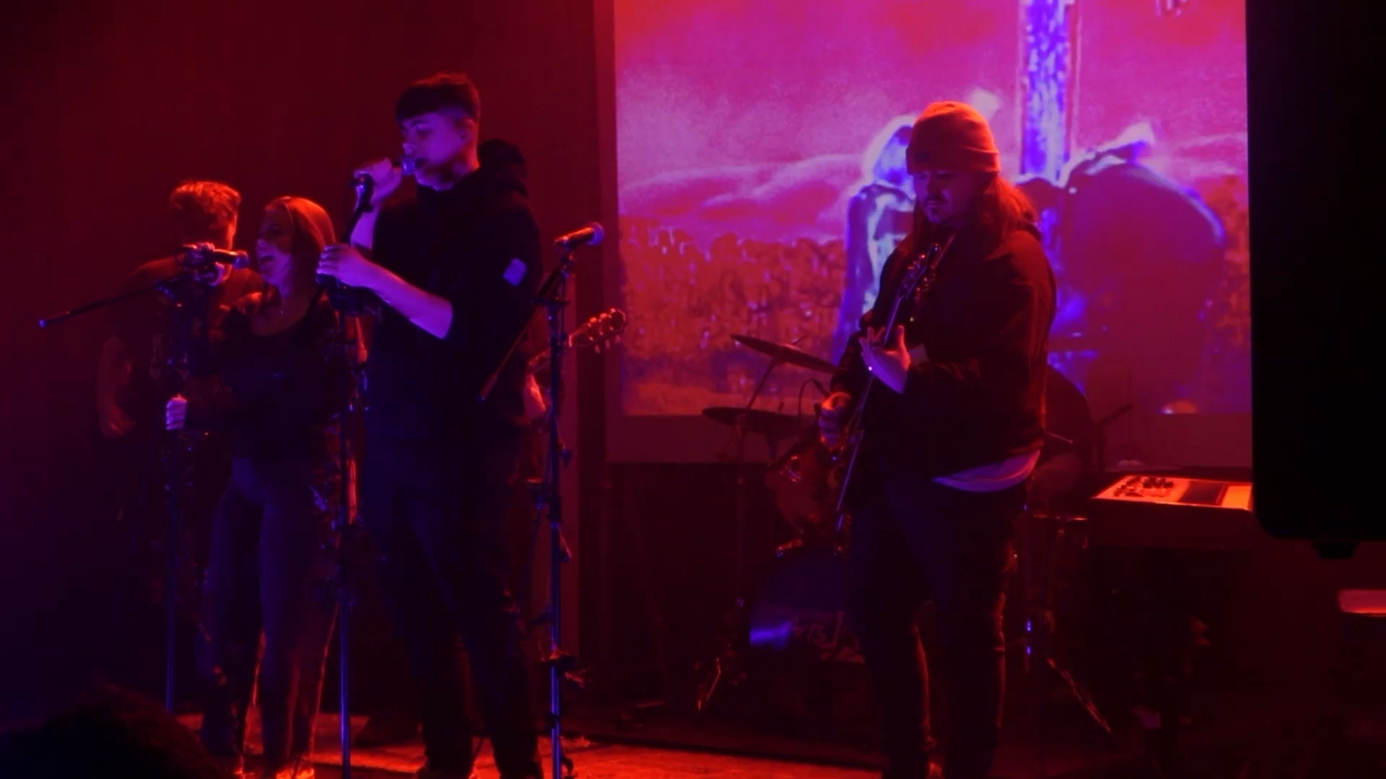
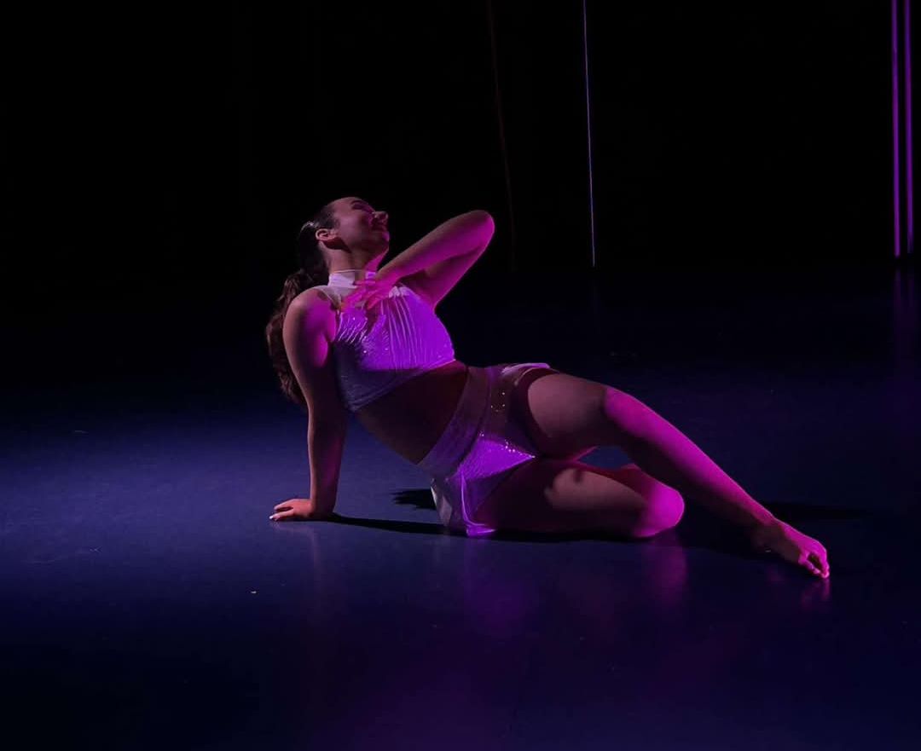
CONTEXT
EXPERIENCE
Our House
Later with Carlisle College
Performing Arts Showcase
College Productions
Notes:
Over past 2 years much experience
Mostly lighting using chamsys magic q, common industry software
Rigging, dmx protocol, health and safety, electrical safety

Slide 4
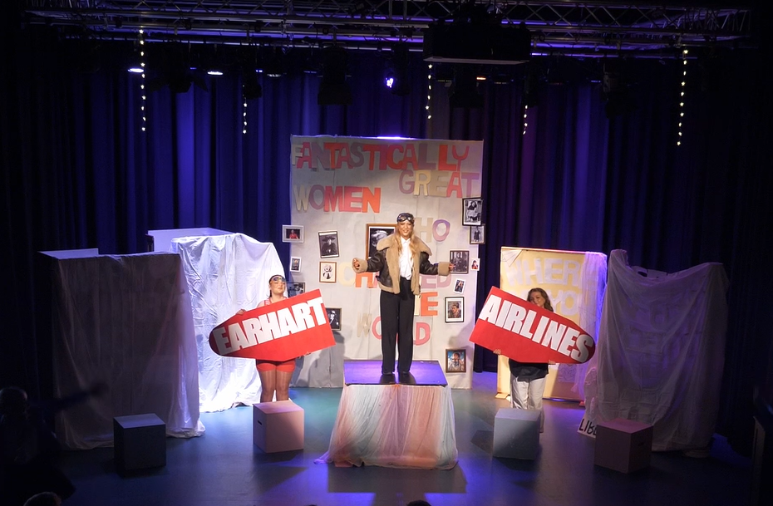
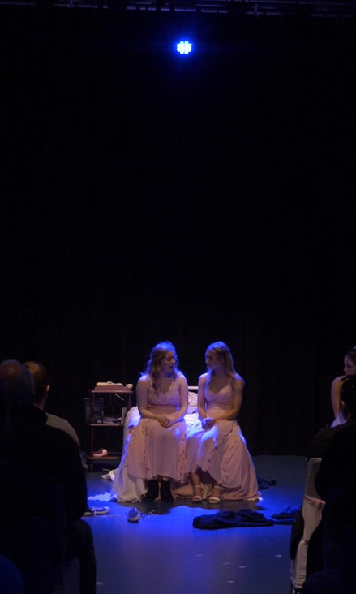
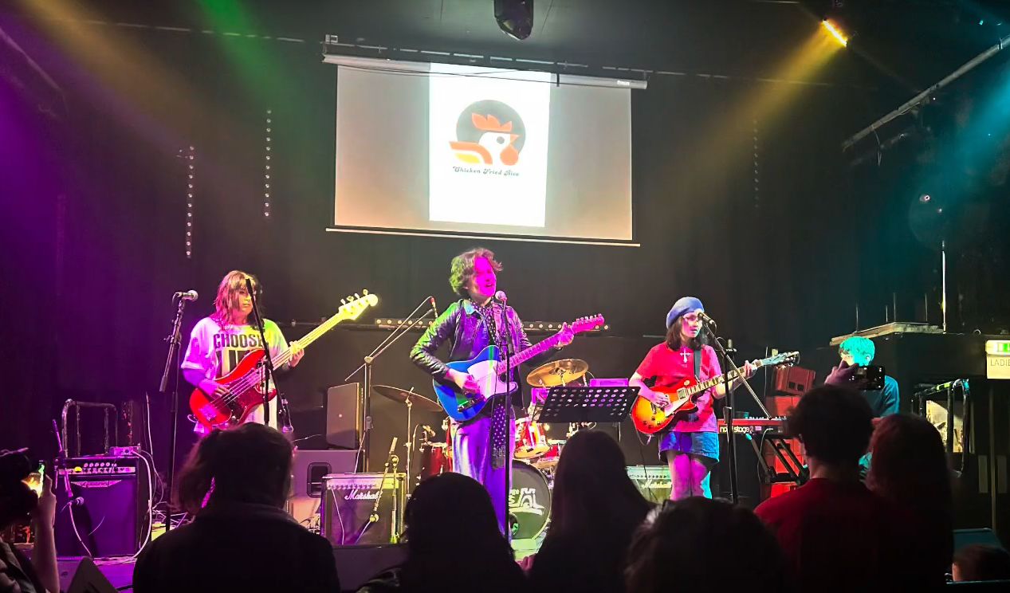
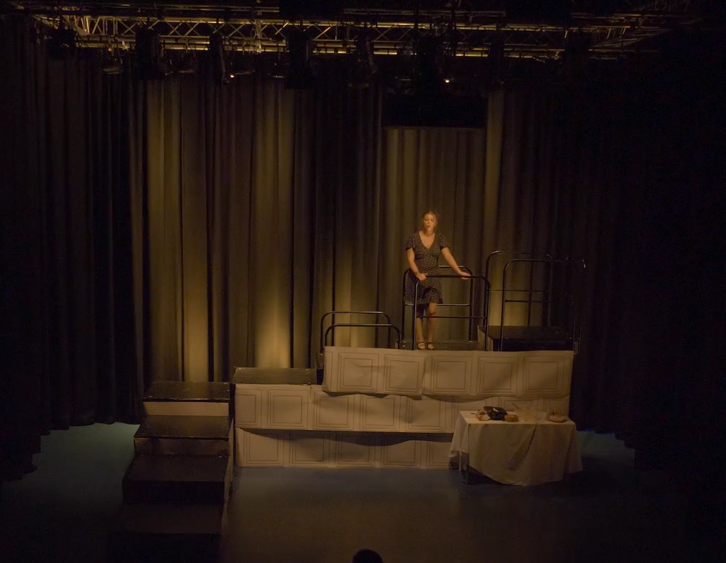
CONTEXT
EXPERIENCE
The Brickyard
Previous FMP Project

Slide 5

RESEARCH
Secondary
Primary
Compare industry standard processes for lighting:
  Design
  Programming
  Operation
Technical specifications of theatres
Chauvet Intimidator Spots
Dan Jones Podcast
Freelancing- Holly Bewley

Slide 6

PROBLEM SOLVING
SWOT ANALYSIS
Strengths
- Thorough knowledge of ChamSys
- Reliabilty
- Basic understanding of live sound setups
- Adaptability and problem solving
Weaknesses
- Confidence
- Limited knowledge of other lighting softwares
- Sound operation
Opportunities
- Broaden my knowledge across other lighting softwares
- Gain contacts and a network in the industry
- Learn industry standard practices
- Develop a portfolio I can proceed with into my career
Threats
- Difficulty finding external placements
- Communication difficulties
- Scheduling conflicts
RESOURCE LIST
Chamsys MagicQ
Lighting Desk
Computer
Lighting Rig
Chauvet Intimidator Spot
DMX Cables

Slide 7

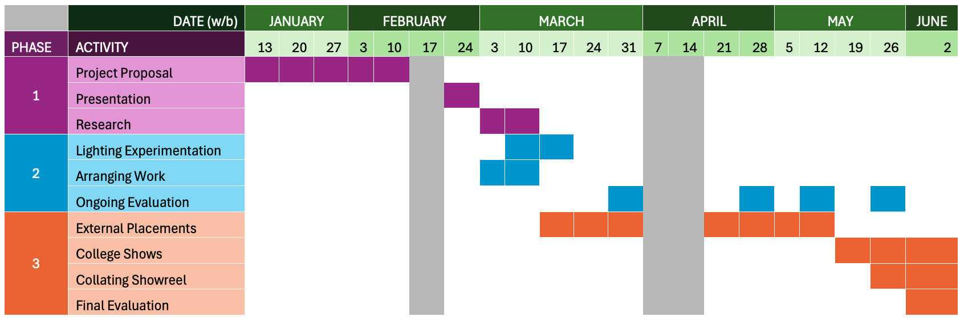
PLANNING + PRODUCTION

Slide 8

PRACTICAL SKILLS
Lighting Software
Knowledge
Lighting Design
Communication

Slide 9
EVALUATION
Reflection after each show
  What practices should I maintain?
  What do I need to improve?
Observational feedback from mentors
Peer feedback for college shows
Final Evaluation

Slide 10



PRESENTATION
Create a showreel
Social Media

Slide 11

BIBLIOGRAPHY
Above AVL (2017). How to Run Lights Live to Music. [online] www.youtube.com. Available at: https://www.youtube.com/watch?v=Asg6-JWKIoc [Accessed 24 Jan. 2025].
Boles, B. (2023). As the technology industry continues to grow, so does the number of women working in it. [online] www.techuk.org. Available at: https://www.techuk.org/resource/as-the-technology-industry-continues-to-grow-so-does-the-number-of-women-working-in-it.html [Accessed 22 Jan. 2025].
Easton, E. and Becket, B. (2021). Freelancers in the Creative Industries. [online] Creative Industries Policy & Evidence Centre. Available at: https://pec.ac.uk/policy-briefings/freelancers-in-the-creative-industries [Accessed 22 Jan. 2025].
International Institute of Live Events (2023). Pathway to event production | How to become an audio engineer or lighting technician. [online] YouTube. Available at: https://www.youtube.com/watch?v=oBQJ3RszWnc [Accessed 24 Jan. 2025].
Martin Professional (2020). Fundamentals of Lighting Design for Concerts with Craig Rutherford - Webinar. [online] www.youtube.com. Available at: https://www.youtube.com/watch?v=06rlK5x3xV4 [Accessed 24 Jan. 2025].
Primrose, J. (2005). Lighting Design - The Process. [online] Theatrecrafts.com. Available at: https://www.theatrecrafts.com/pages/home/topics/lighting/lighting-design-process/ [Accessed 24 Jan. 2025].
The Big Freelancer Survey 2023. (2023). [online] Freelancers Make Theatre Work, p.8. Available at: https://freelancersmaketheatrework.com/wp-content/uploads/2023/06/FMTW-Big-Freelancers-Report-2023.pdf [Accessed 22 Jan. 2025].

Slide 12

THANK YOU FOR LISTENING

